Slide 1
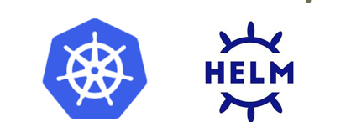
Kubernetes & Helm basic concepts
Eetay natan
PRINCIPAL ARCHITECT HARMAN CLOUD & EDGE
OCT-2020

Slide 2
KUBERNETES
ARCHITECTURE

Slide 3
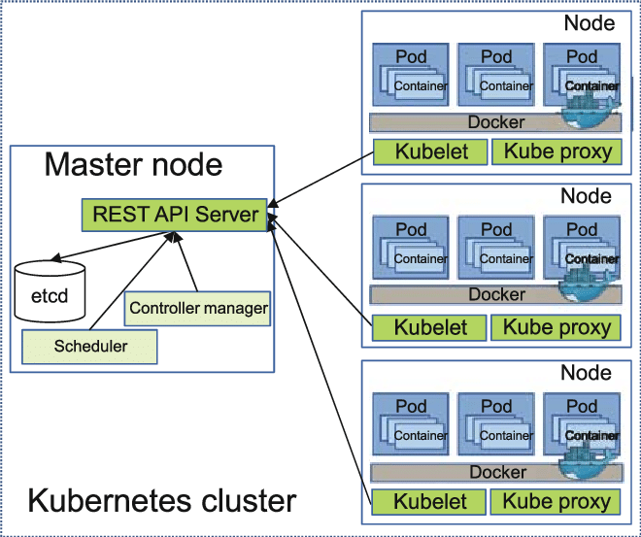

K8S CLUSTER COMPONENTS
API server is the front end for the Kubernetes control plane
etcd is a distributed key-value store for all K8S cluster data
kube-scheduler watches for newly created pods and selects a node for them to run on
kubelet is the agent that runs on each node and makes sure that containers are running
kube-proxy is a network proxy that runs on each node, distributing traffic between nodes
(worker)
(worker)
(worker)
“Docker” can be replaced with another container service

Slide 4
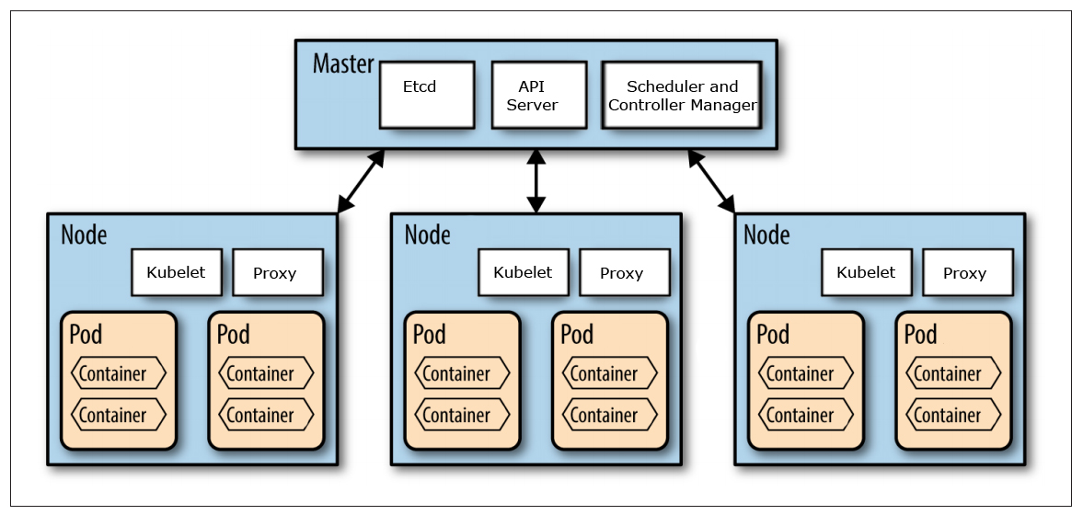
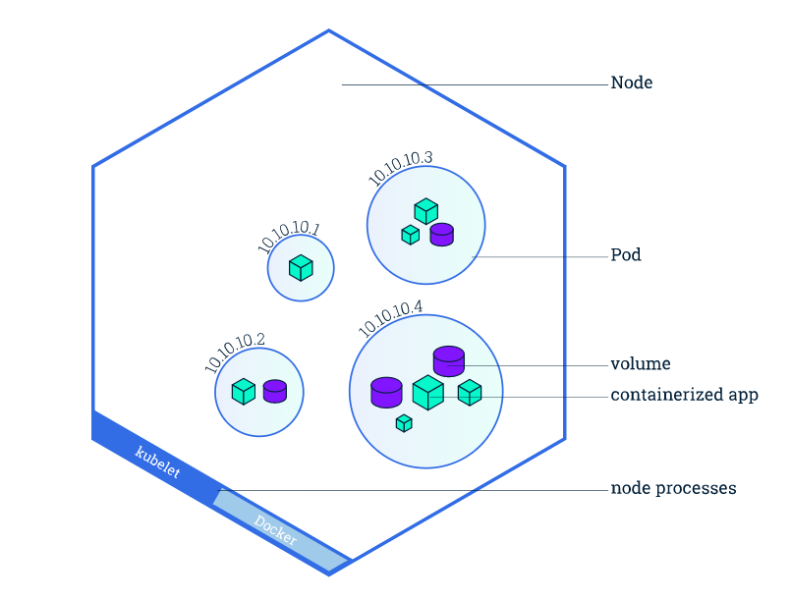
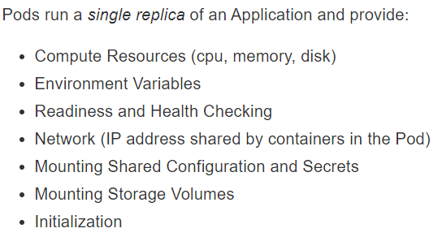
NODE – POD - CONTAINER
Pods run a single replica of an Application
An Application is a set of containers
A Container is an execution of a docker-image
kubectl get nodes kubectl get pods

Slide 5

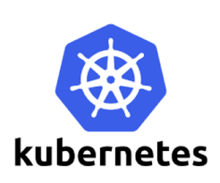
DECLARATIVE CONFIGURATION
Applications installation and ongoing management (via K8S) use the same process
Applications can have runtime configuration managed in DB or other means, not related/visible/managed by K8S
Change config
Config A (existing)
---
No prior config
Config A
----
Config B (desired)
Config B (existing)
---
Config A (old)
K8S database
K8S database
K8S database
Apply change
Notes:
https://medium.com/better-programming/10-antipatterns-for-kubernetes-deployments-e97ce1199f2d

Slide 6
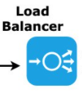
HIGH AVAILABILITY QUIZZ – CLUSTER LEVEL
Worker Node
kube proxy
Worker Node
Worker Node
Master Node
AZ1
kube proxy
AZ2
Master Node
Worker Node
Worker Node
Worker Node
Master Node
kube proxy
kube proxy
AZ1
AZ2
Worker Node
Master Node
Worker Node
Master Node
Master Node
In a single master, the cluster does not respond to node failures, create resources, move pods, etc. until master is back. However, in any case, life for applications will continue as normal unless nodes are rebooted.
Notes:
https://medium.com/velotio-perspectives/demystifying-high-availability-in-kubernetes-using-kubeadm-3d83ed8c458b
https://stackoverflow.com/questions/39172131/what-happens-when-the-kubernetes-master-fails

Slide 7
HIGH AVAILABILITY QUIZZ – POD/APP LEVEL
Worker Node A
W. Node A
W. Node A
AZ1
kube proxy
Pod
appX
Pod
appX
kube proxy
Pod
appX
kube proxy
Vault pod
AZ2
Worker Node B
W. Node B
W. Node B
Pod
appX
Vault pod
Vault pod

Slide 8
KUBERNETES
RESOURCES

Slide 9
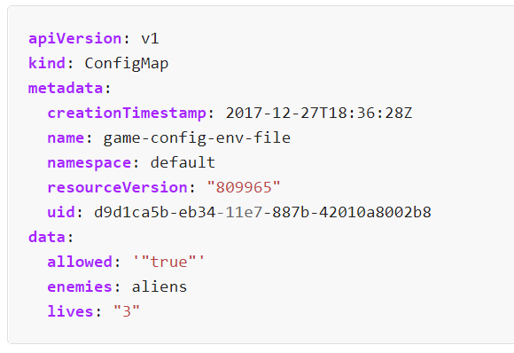
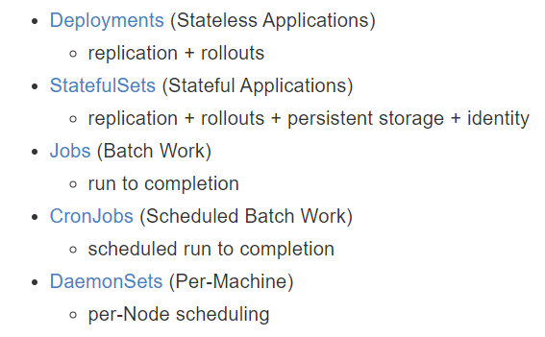
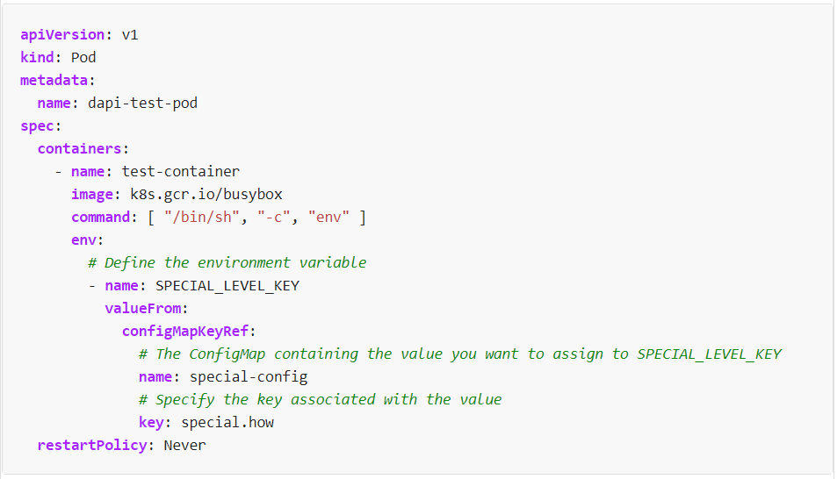
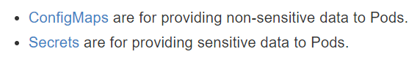
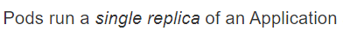
TYPES OF K8S RESOURCES
special-config
special-config
Volumes

Slide 10
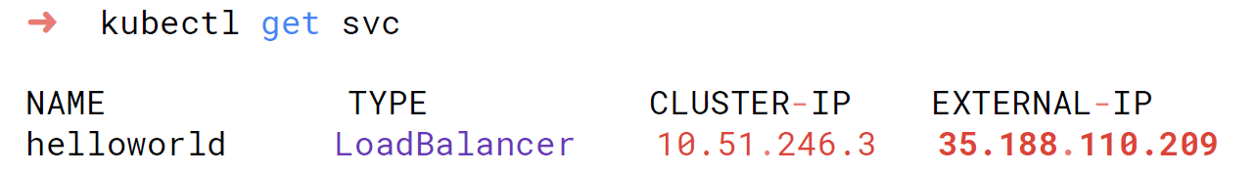
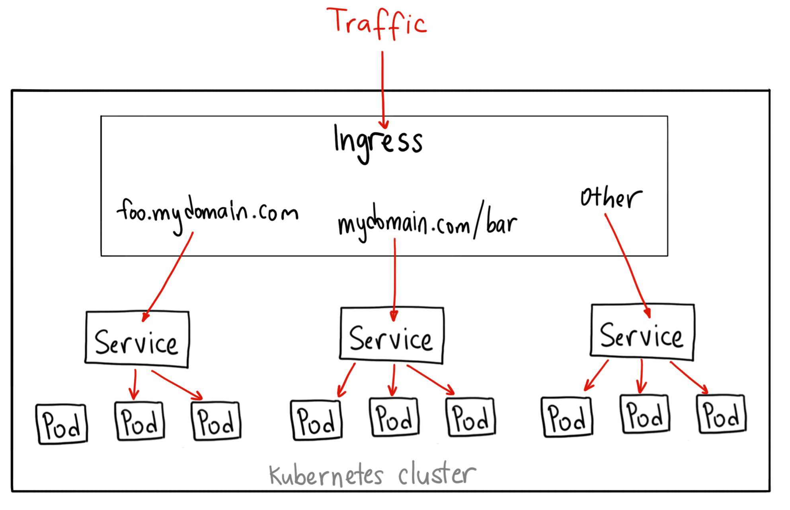
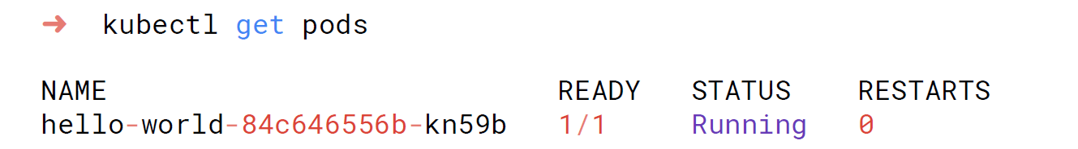
INGRESS – SERVICE - POD

Slide 11
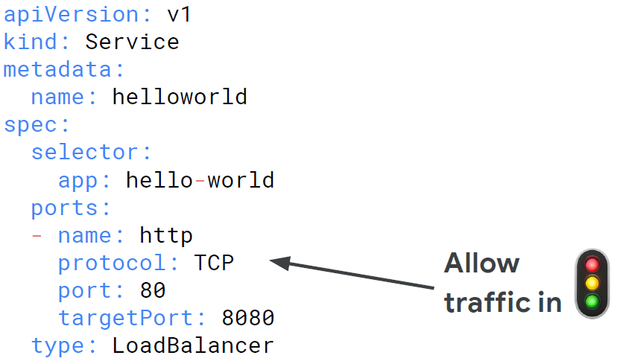
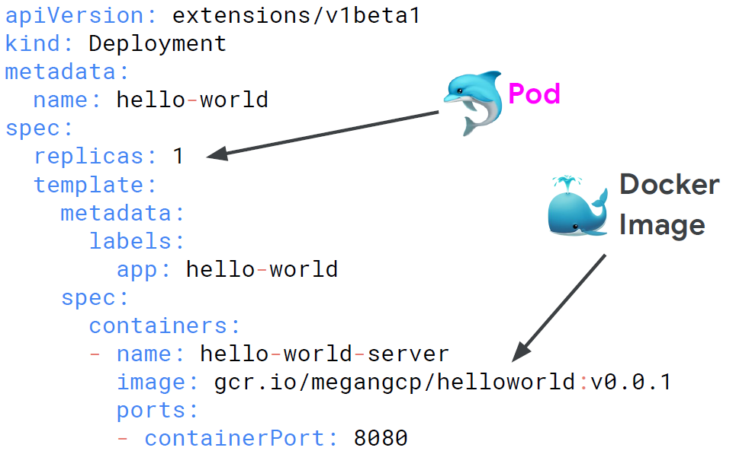
DEPLOYMENT - service
A service
is responsible for network access to a set of pods
A deployment is responsible for keeping a set of pods running
s
Applications in the Pod
kubectl edit svc
kubectl edit deployments

Slide 12
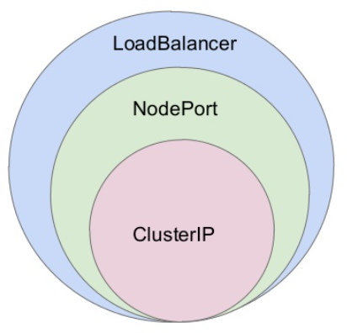
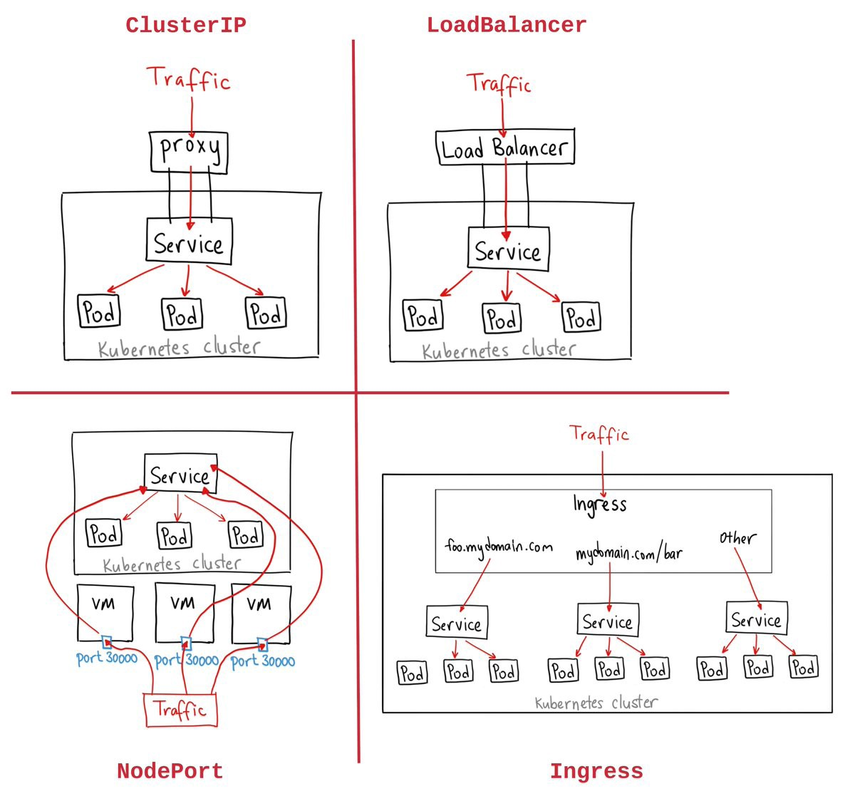
TYPES OF SERVICES
ClusterIP gives you a service inside the cluster where applications (containers) from the cluster can access the service
NodePort service opens a specific port on all the machines running the cluster (= Kubernetes nodes) and forward traffic to the service
LoadBalancer is a service exposed to the internet. each service you expose with a LoadBalancer will get its own IP address
Ingress is actually NOT a type of service. it sits in front of multiple services as a “smart router”. There are many types of Ingress controllers that have different capabilities
Notes:
https://medium.com/google-cloud/kubernetes-nodeport-vs-loadbalancer-vs-ingress-when-should-i-use-what-922f010849e0
https://stackoverflow.com/questions/41509439/whats-the-difference-between-clusterip-nodeport-and-loadbalancer-service-types

Slide 13
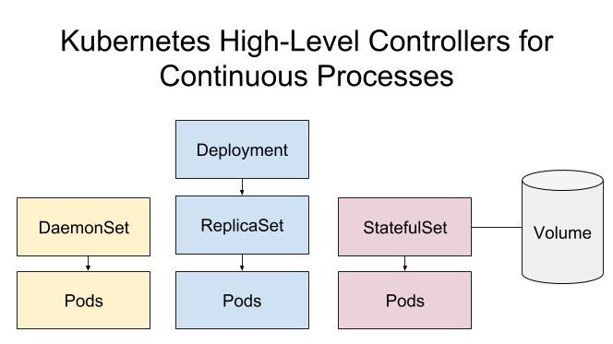
DEPLOYMENT – REPLICA SET – DAEMONSET - STATEFULSET
different resources that Kubernetes provides for deploying pods.
Deployment is a controller that matches the current state of your cluster to the desired state (the Deployment manifest).
Deployments creates a ReplicaSet which then creates a Pod
ReplicaSet is a controller that manages the deployment and scaling of a set of Pods
StatefulSet is a controller that manages the deployment and scaling of a set of Pods, providing a guarantee on the ordering and uniqueness of these Pods.
DaemonSet is a controller that ensures that the pod runs on all the nodes of the cluster. If a node is added/removed from a cluster, DaemonSet automatically adds/deletes the pod.
Notes:
https://medium.com/stakater/k8s-deployments-vs-statefulsets-vs-daemonsets-60582f0c62d4

Slide 14
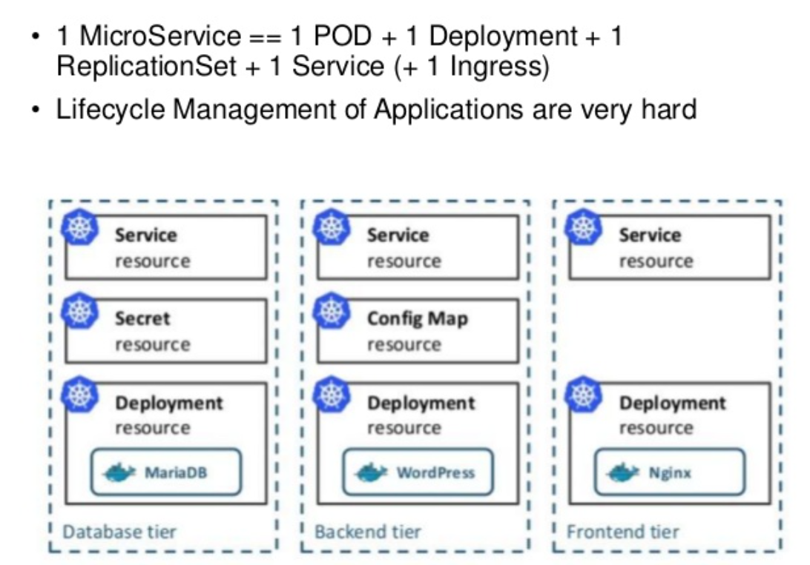
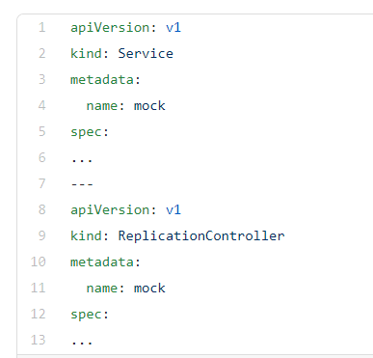
COMBINING TYPES OF K8S RESOURCES
One application - example
One YAML file (optional)

Slide 15
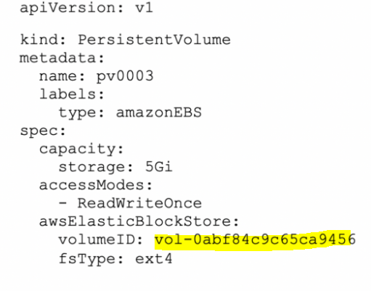
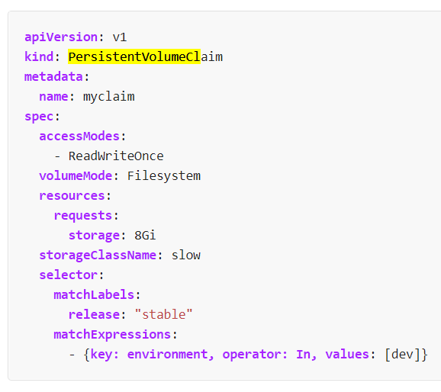
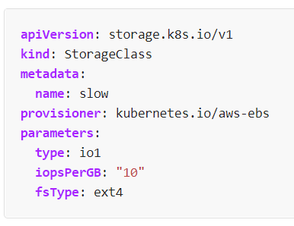
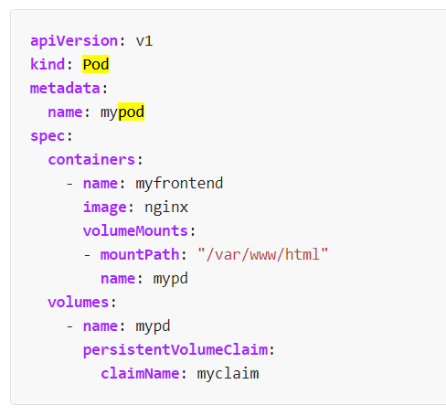
PERSISTENT VOLUMES
A PersistentVolume (PV) is used to manage durable storage in a cluster.
typically backed/implemented by cloud persistent disks (e.g. EBS, EFS, NFS, …)
exist independently of Pods.
A PersistentVolumeClaim (PVC) is a request for a PersistentVolume resource.
The request specify size, access mode, and StorageClass
PersistentVolumeClaim is “bound” to a PersistentVolume if one exists which satisfies the request exists
kubectl apply
cloud
Kube cluster
PV
Cloud “physical” storage
Notes:
https://portworx.com/tutorial-kubernetes-persistent-volumes/

Slide 16
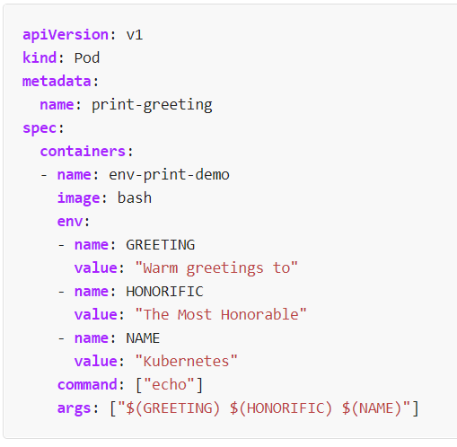
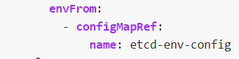
PASSING VALUES TO PODS USING ENVIRONMENT VARIABLES
kubernetes ➔ pod ➔ docker ➔ docker container running “bash” image ➔ /bin/bash process in container

Slide 17
KUBERNETES
EXTRA

Slide 18
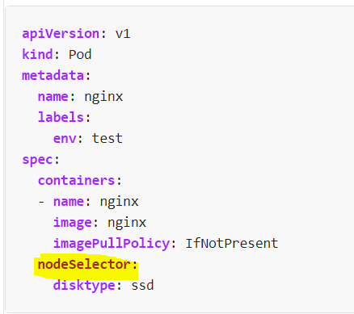
Assigning Pods to Nodes ( AFFINITY )
nodeSelector is a field of PodSpec. It specifies a list of key-value pairs. For the pod to be eligible to run on a node, the node must have each of the indicated key-value pairs as labels
The affinity feature has "node affinity" and "inter-pod affinity/anti-affinity".
node affinity is like nodeSelector but more expressive
inter-pod affinity/anti-affinity constrain against labels on other pods running on the node

Slide 19
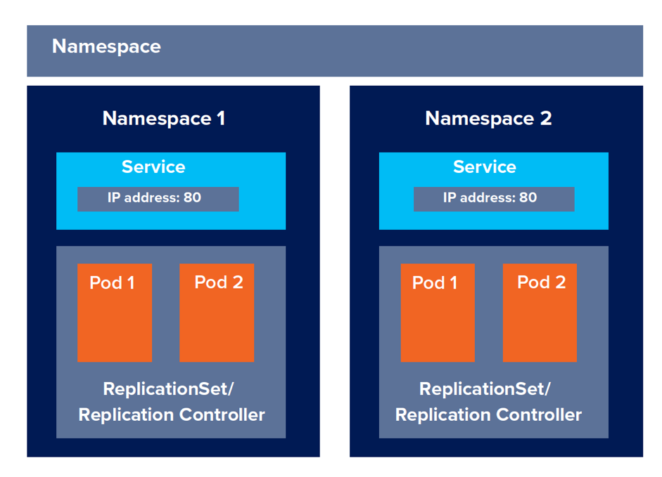
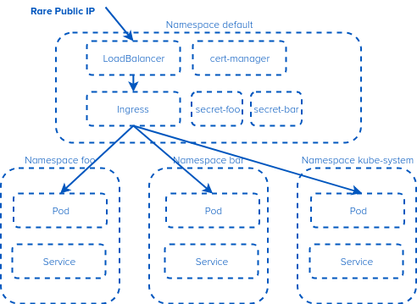
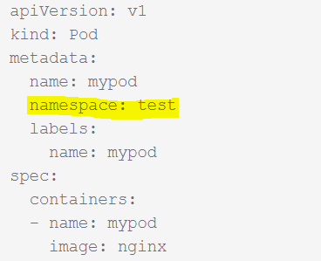
NAMESPACES
Kubernetes supports multiple virtual clusters backed by the same physical cluster. These virtual clusters are called namespaces
there are three namespaces that Kubernetes ships with:
Default
kube-system (used for Kubernetes components)
kube-public (used for public resources).
Best Practice: NOT mixing both production and non-production workloads in the same cluster
Notes:
https://cloud.google.com/blog/products/gcp/kubernetes-best-practices-organizing-with-namespaces

Slide 20
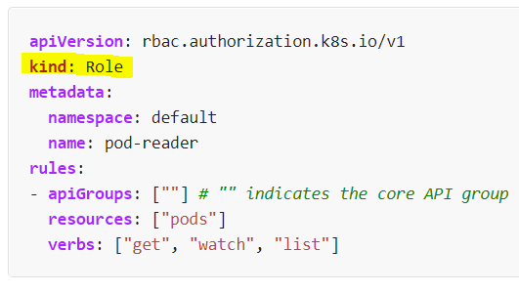
Role BASED AUTHORIZATION: RBAC
A Role always sets permissions within a particular namespace. A ClusterRole is cluster-wide equivalent of Role
A Role or a ClusterRole contains rules that represent a set of permissions. Permissions are purely “allow” (no "deny" rules)
RoleBinding or ClusterRoleBinding grants the permissions defined in a role to a user or users
Cluster-wide
namespace specific
Role
ClusterRole
RoleBinding
ClusterRoleBinding
User
Notes:
https://thenewstack.io/three-realistic-approaches-to-kubernetes-rbac/

Slide 21
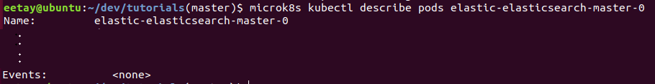
TRIAGE WITH KUBECTL
kubectl get pods
- Status!! - Number of active replicas, vs. planned - Age - Restart (do we see a lot of restarts??)
kubectl logs <pods>
- Console logs of application running inside the pod
kubectl describe pods <pods>
- Error events from Kubernetes itself while managing the pod (e.g. during init)
- Which docker/containerd ID

Slide 22
TRIAGE WITH KUBECTL: “GET” VS “DESCRIBE”
kubectl get shows tables by default. (You can view/visualize large number of objects easily)
kubectl describe shows the detailed description. (Better for a single object)
kubectl describe is more flattened, has lesser data and easier to read than the full object data given by kubectl get -o yaml
po/pods
get
kubectl
no/nodes
Optional: -n <namespace>
Default: show namespace “default”
Optional: <object ids>
Default: show all
describe
deploy/deployment
edit
svc
pvc
…

Slide 23
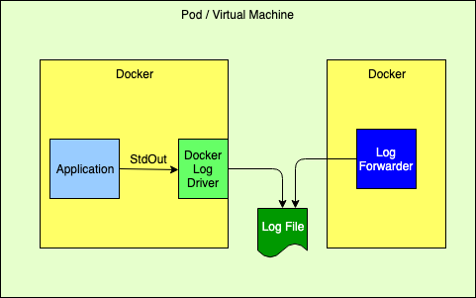

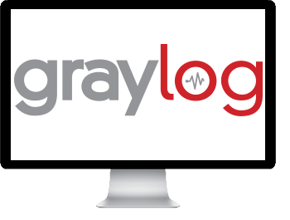
LOGGING - POSSIBLE ARCHITECTURES
A. console and forwarder
kubectl logs <pods>
C. Logback and forwarder
B. console and GELF driver
Pod
Pod
Docker (container)
Docker (container)
Docker (container)
Docker GELF driver
Log Forwarder
Application in-app logback
Application
StdOut

Slide 24
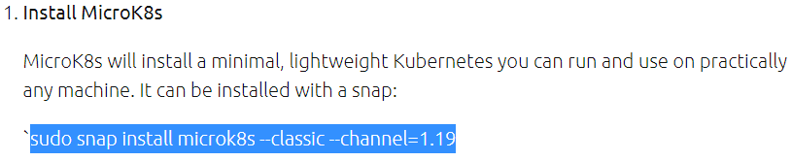
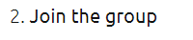
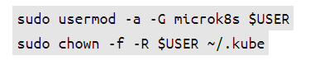
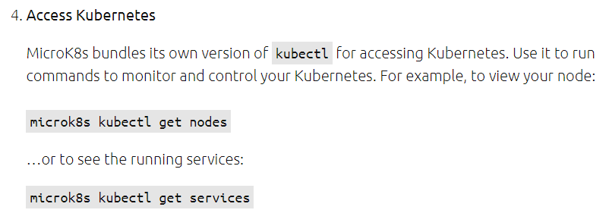
FAST HANDS-ON WITH MICROK8S
MicroK8S is a zero-ops, high availability, autonomous, clustered, production-grade K8s.
https://microk8s.io/docs

Slide 25
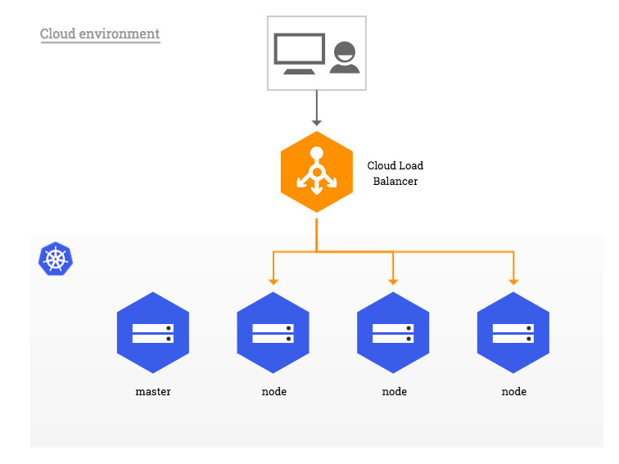
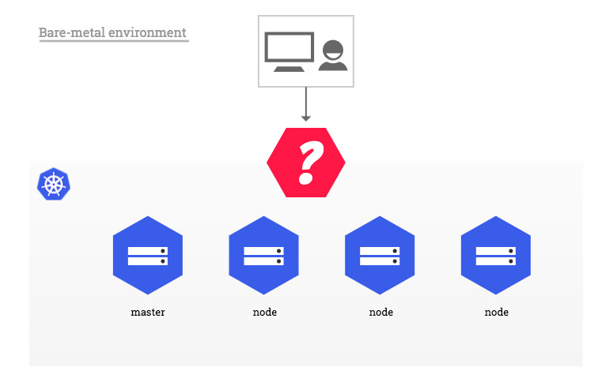
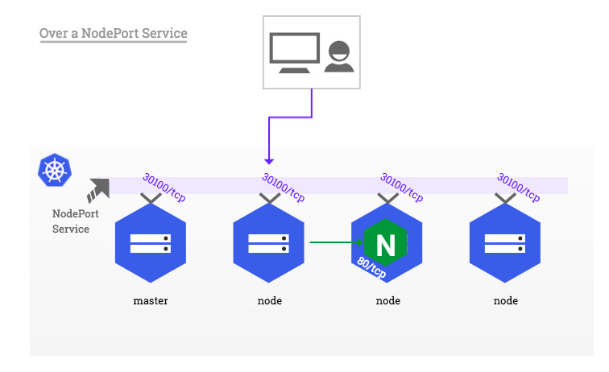
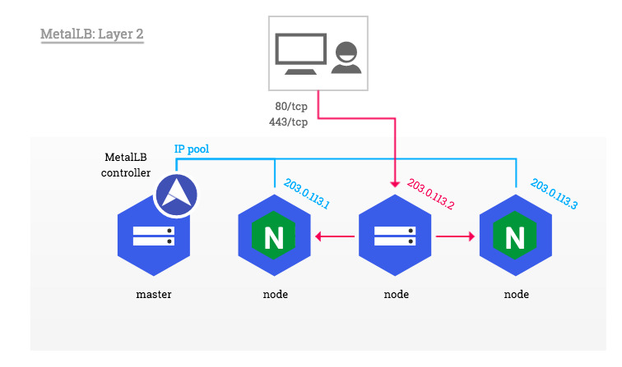
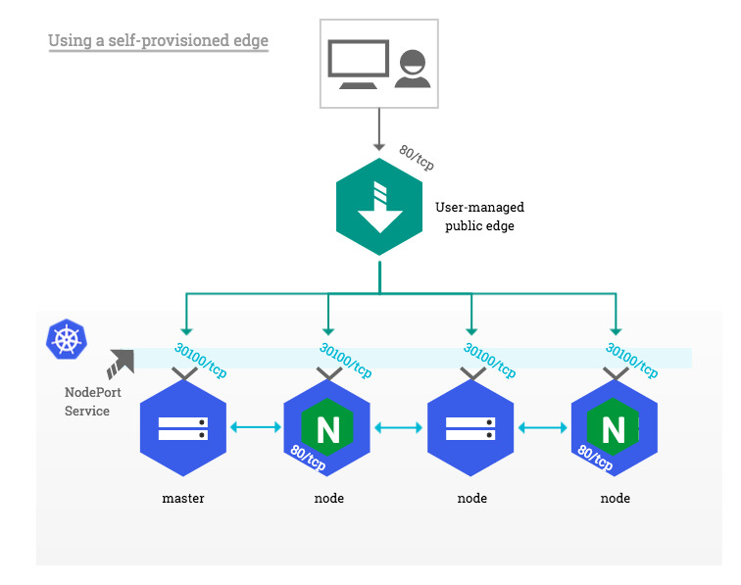
KUBERNETES LB ON-PREM (BARE-METAL)
Notes:
https://kubernetes.github.io/ingress-nginx/deploy/baremetal/

Slide 26
HELM
USING HELM

Slide 27
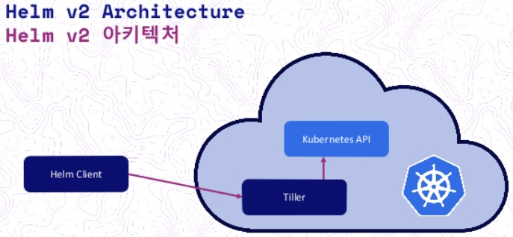

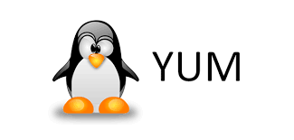
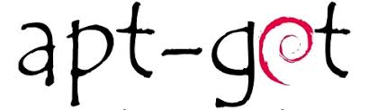

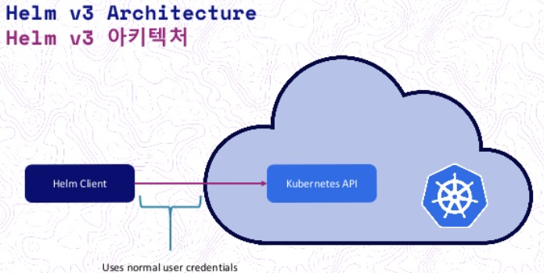
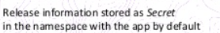
HELM OVERVIEW
Helm is a package manager for Kubernetes
=~
Admin’s machine
Helm operates on/inside K8S.
Helm client (cli) runs anywhere
Helm client (cli) uses kubeconfig file to find the cluster
from ~/.kube/config or $KUBECONFIG
Helm Terms
* Release is a name/label for deployed chart (i.e. a deployed ‘application’)
* Chart is a collection of K8S resources (i.e. a definition of a ‘application’)
* “Helm” often means Helm cli client
Admin’s machine

Slide 28

HELM LIFECYCLE
Helm pull [chart]
Local disk with charts
Helm install [name] [chart]
Helm upgrade [release] [chart]
Helm uninstall [release]

Slide 29


WORKING WITH HELM (SYS ADMIN’S HAT)
helm repo list list chart repositories
helm repo add add a chart repository
helm search search for a keyword in charts
helm pull download a chart from a repository and (optionally) unpack it in local directory
helm show values show the chart's values
helm history fetch release history
helm install deploy a chart
helm list list releases
helm upgrade modifies a release

Slide 30

EXAMPLE: INSTALLING ELASTICSEARCH WITH HELM (1/2)
(1) helm search repo
Looking to a suitable chart
(2) helm install
I named my release (of “stable/elasticsearch”) “elastic”
(3) helm history
Checking to see results of install
(4) I inspected the resources with kubectl (see next slide)

Slide 31


EXAMPLE: INSTALLING ELASTICSEARCH WITH HELM (2/2)
Statefulset is used for actual elastic nodes because with elastic, nodes contain their own data volume (each)
Deployment is used for the client nodes, which are just stateless proxies
Configmap holds most configuration values
Pods are the actual running elastic servers. I have one master and one non-master data nodes. I have 2 client nodes to serve requests
Services are the traffic distributers in the system, there’s one to split traffic between the 2 client nodes, and one for discovery

Slide 32
HELM
CHARTS

Slide 33



HELM CHARTS
Chart.yaml defines the required sub-charts
Template files GO-templates which generate k8s resource files
Notes:
https://blog.gopheracademy.com/advent-2017/using-go-templates/

Slide 34




PARENT CHARTS
override values
imported values
chart-global values
values
values
when Helm installs/upgrades charts,
the Kubernetes objects from the charts and all its dependencies are aggregated into a single set
sorted by type followed by name
created/updated in that order.
This means installation order is NOT by chart, but rather by resource type
Best Practice: Dependency declaration between applications (chart of charts)
Notes:
https://codefresh.io/docs/docs/new-helm/helm-best-practices/

Slide 35









WHERE DO WE MANAGE THE CONFIGURATION?
OPTIONAL
package
pull
install/update
Admin VM
GIT
Local disk
1. edited charts .
2. value overrides
cluster
git push
pull – edit - push
edit + helm-install
kubectl edit
kubectl
no version control
no audit/history
no rollback
no backup
version control
audit trail
no version control
Local audit trail
Best Practice: A registry of available applications to be deployed (Helm repository)
Notes:
https://codefresh.io/docs/docs/new-helm/helm-best-practices/
https://medium.com/better-programming/10-antipatterns-for-kubernetes-deployments-e97ce1199f2d

Slide 36
HELM
CHART DEVELOPMENT

Slide 37

HELM CHART HOOKS
Hooks allow chart developers to perform operations at strategic points in a release lifecycle
Hooks are actually regular templates (i.e. they are resources), but annotated, so Helm to utilize them differently.
For a Job or Pod resource, Helm will wait until it successfully runs to completion. Failure is fatal
For all other resource kinds, as soon as resource is loaded (added or updated), the hook is "Ready"
Best Practice: Built-in rollback of a chart to a previous version without running a CI/CD pipeline
Best Practice: Manage installation/upgrades of charts as a whole

Slide 38
BEST PRACTICES FOR CHART DEVELOPERS
have metrics in place to verify a deployment was successful (could be a post-install hook test)
Always define pod’s memory and/or CPU limits
Do NOT assume deployment order. (Applications shouldn’t crash because a dependency isn’t ready.)
using Helm or other kinds of templating
Do NOT put configuration inside/alongside the Docker image; Manage all configuration within the chart (or else runtime/DB)
Group values by purpose: (A) developer/debugging/default-setting (B) must have customization (C) one-time initialization, …
“The Chart Best Practices Guide” – IMPORTANT! But is a presentation unto itself
https://medium.com/better-programming/10-antipatterns-for-kubernetes-deployments-e97ce1199f2d
https://codefresh.io/docs/docs/new-helm/helm-best-practices/
https://helm.sh/docs/chart_best_practices/

Slide 39
SUBJECTS NOT COVERED IN THIS PRESENTATION
Chart Dependencies
Library charts A library chart is a type of Helm chart that defines chart primitives or definitions which can be shared by Helm templates in other charts. This allows users to share snippets of code that can be re-used across charts, avoiding repetition and keeping charts DRY.
Helm Schema validation
CRDs, Custom resources https://www.bmc.com/blogs/kubernetes-crd-custom-resource-definitions/
Operators https://kubernetes.io/docs/concepts/extend-kubernetes/operator/
Secrets
Chart best practices https://helm.sh/docs/chart_best_practices/
Service Account
Kustomize (separate presentation)
Troubleshooting
Rolling updates, etc.
Notes:
https://lzone.de/blog/Helm+Best+Practices

